Slide 1
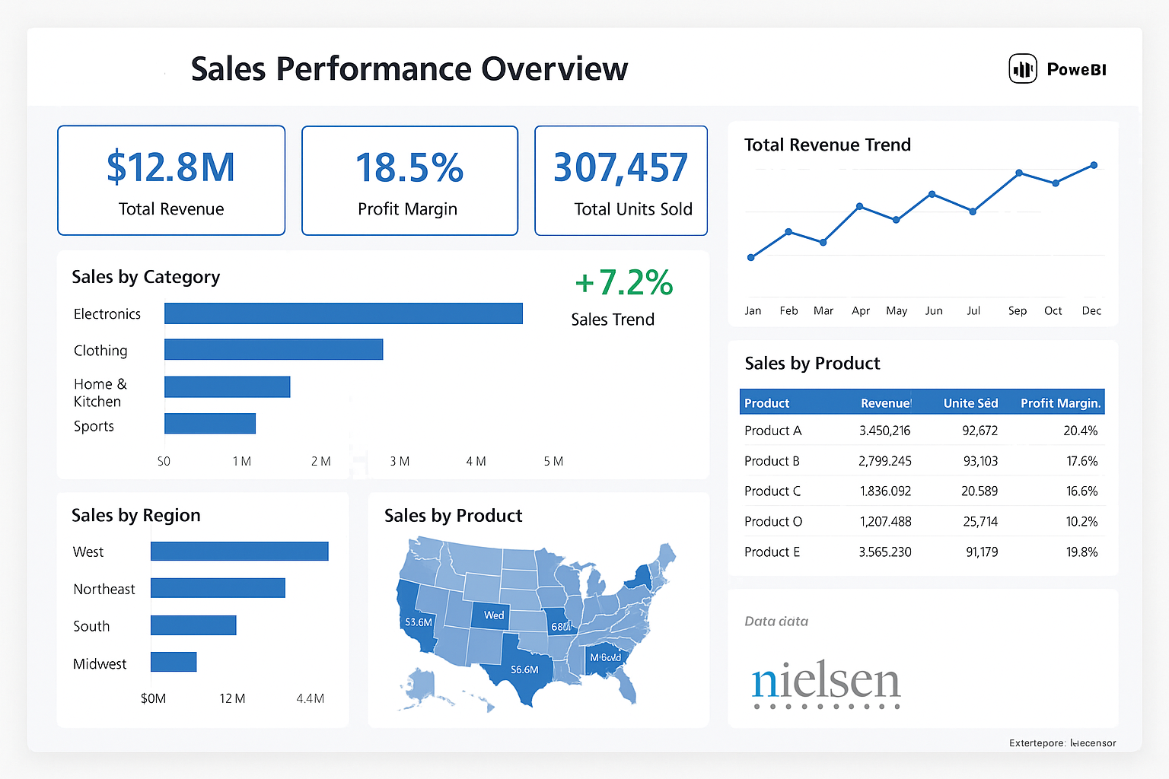

Slide 2
E-Commerce Sales Intelligence
Sales Dashboard Summary (Excel Insights)

Slide 3
Dashboard Overview
- Raw sales data from Amazon platform
- Region and category level summaries
- Monthly trend analysis
- Key KPIs: Revenue, Units Sold, Profit Margin

Slide 4
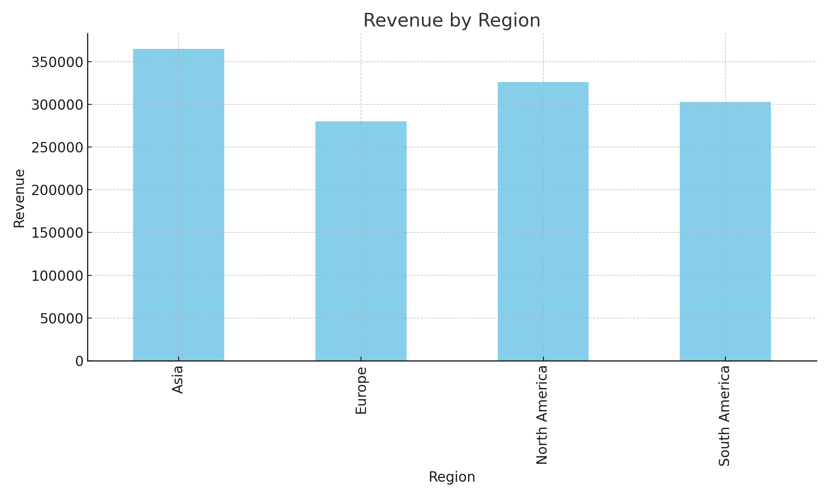
Region-Level Performance

Slide 5
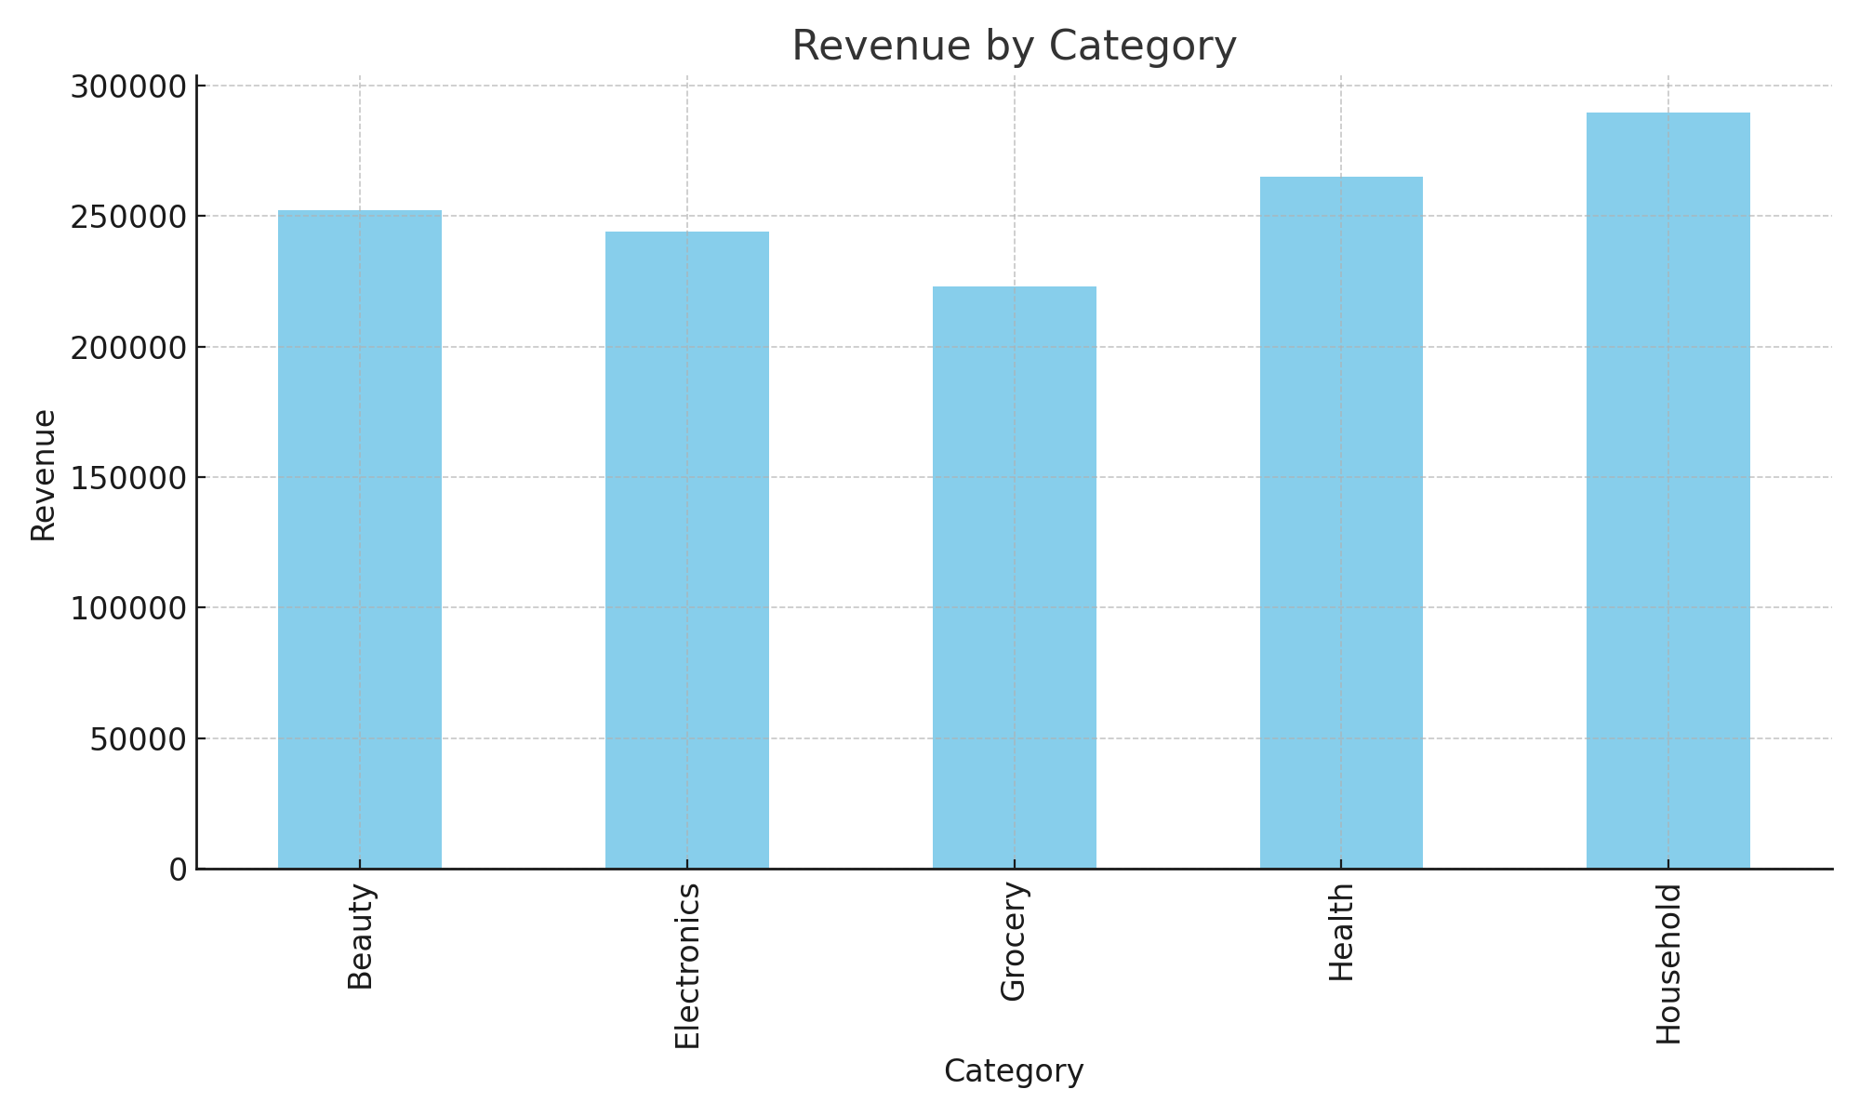
Category-Level Performance

Slide 6
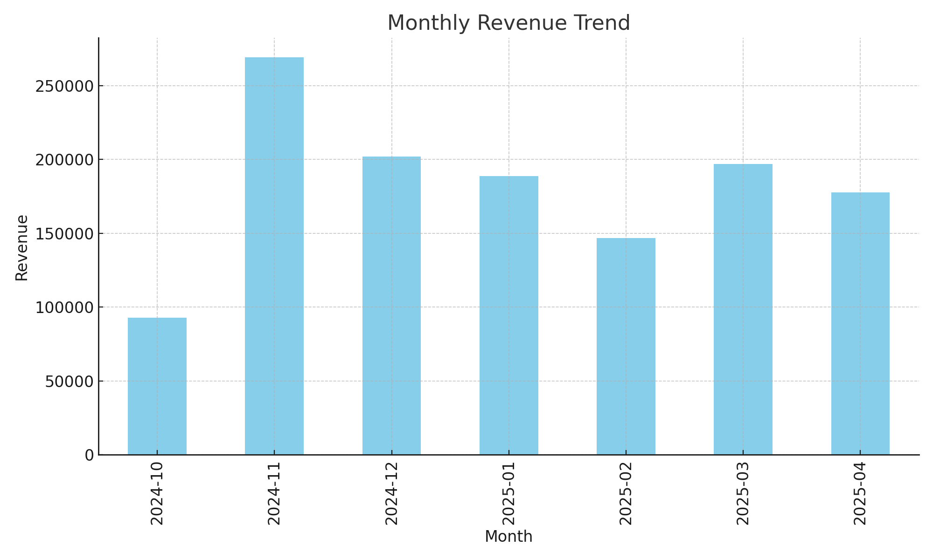
Monthly Sales Trend

